Slide 1


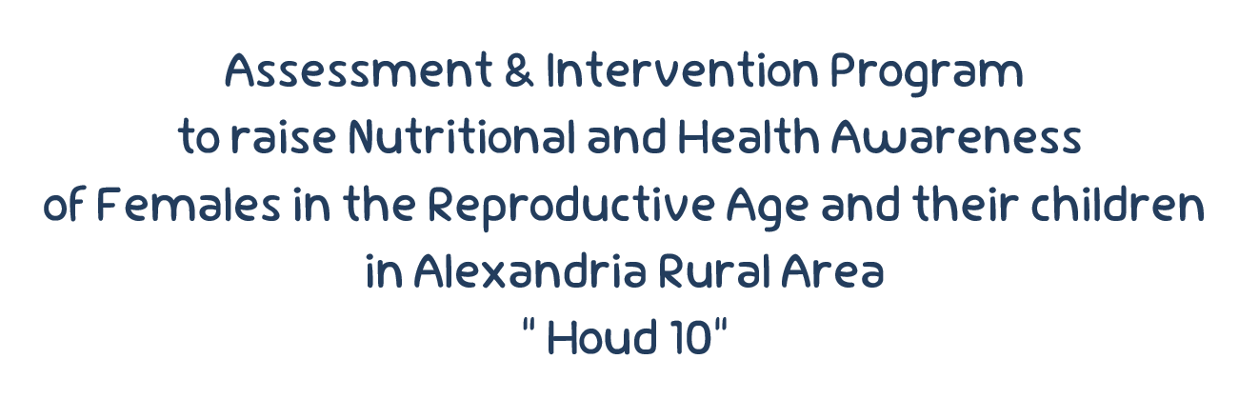








Slide 2
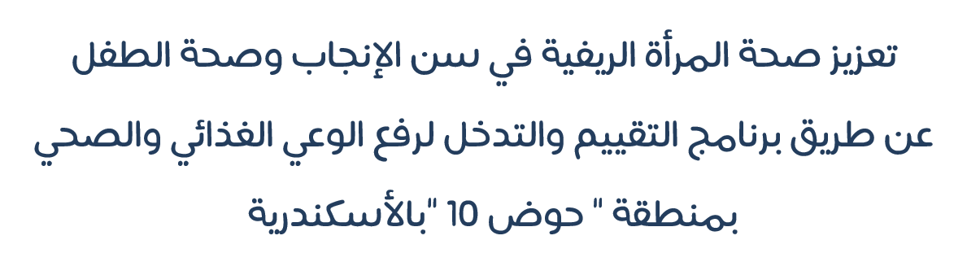

Slide 3


Introduction

Slide 4




Intro
Healthy females are the cornerstone of healthy societies.
Women’s health is a reflection of
society’s health.

Slide 5



Situation in Egypt
CAPMAS
Egypt Population
> 100 M
Egyptian Women
> 48.5 M
Females of childbearing age
> 24 M

Slide 6
Situation in Egypt
Women in this region and their children accordingly suffer from many nutritional problems which may be due to undernutrition (such as anaemia, stunting, under weight and wasting) or may be due to over nutrition (such as obesity and obesity related diseases).

Slide 7

Situation in Egypt
Within the framework of the state’s efforts to build the Egyptian person in terms of health, several presidential initiatives were launched.

Slide 8
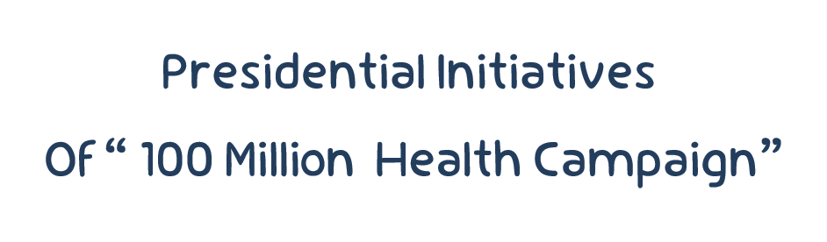



Slide 9


Slide 10

Aim of
The Project

Slide 11


Our Aim
  To Assess the nutritional status & Improve nutritional awareness of childbearing aged females in
  ‘’Houd 10’’, Alexandria.

Slide 12
Action plan

Slide 13



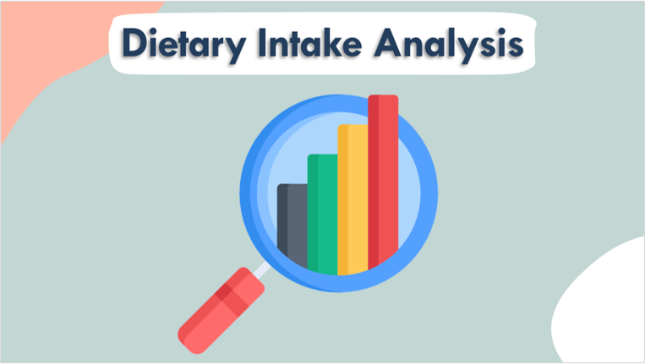

Slide 14

Teamwork

Slide 15

Teamwork
  Nutrition Department Students
  Under the supervision of Nutrition department Staff
  جمعية النفوس الرحيمة
  الجهاز المركزى للتعبئة و الاحصاء
  Biostatisticians
  Laboratory doctors and technicians

Slide 16





Teamwork
Facilitating the implementation of the project
Recruiting the
Target group
229 females
(18-45 years old)

Slide 17



Teamwork
Facilitating the implementation of the project
for data collection
Provide a Place
education sessions

Slide 18
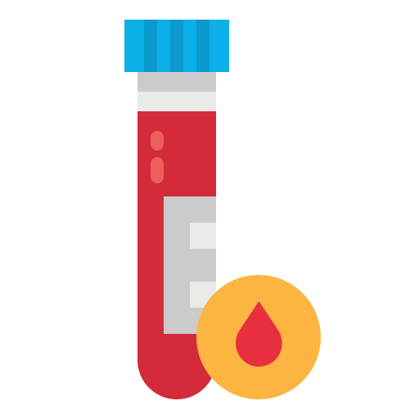
Teamwork
  جمعية النفوس الرحيمة
Communicating with the lab for sample collection

Slide 19

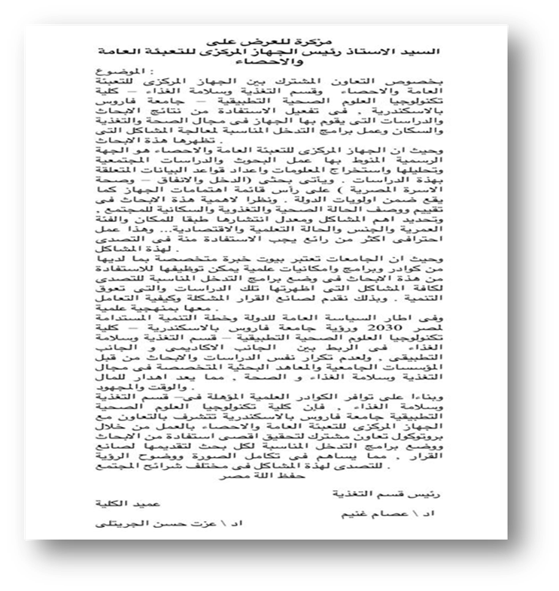
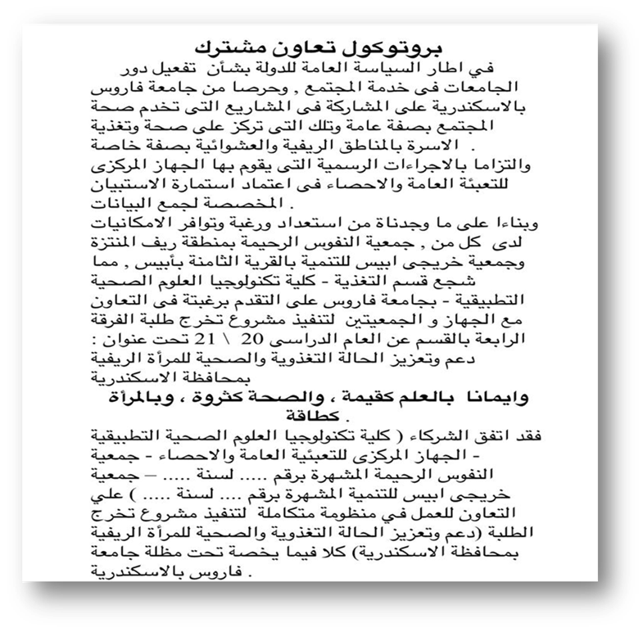

Slide 20

Data Collection

Slide 21


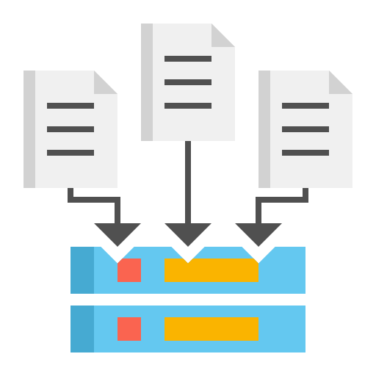

Data Collection
Anthropometric Assessment
Interviewing
Biochemical Tests

Slide 22



Data Collection
Interviewing
Pre-designed questionnaire
Each one lasted for
20 minutes

Slide 23





Data Collection
Interviewing
Types of data were collected
Socio-demographic data
Medical History
Dietary History

Slide 24
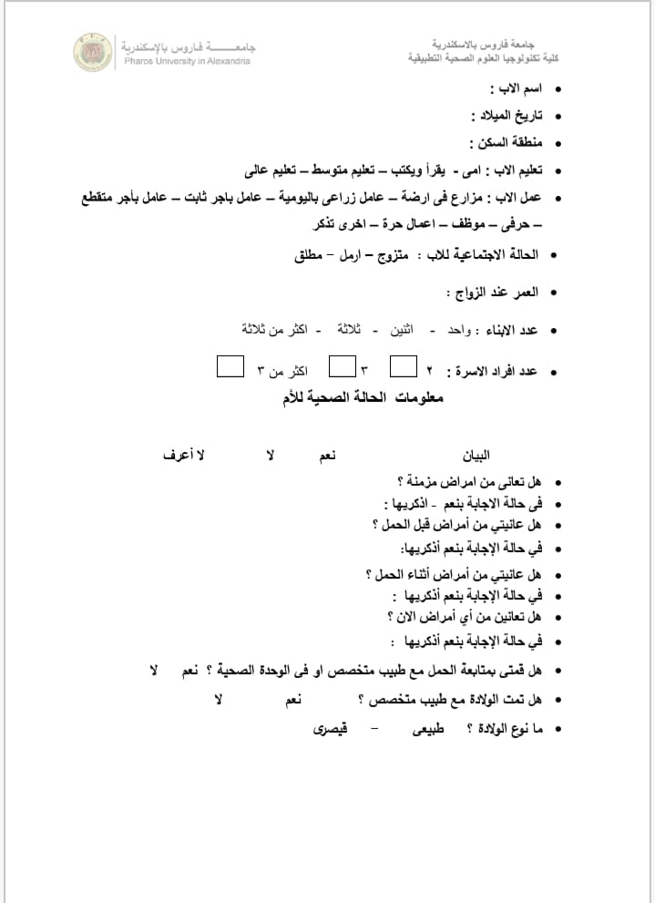
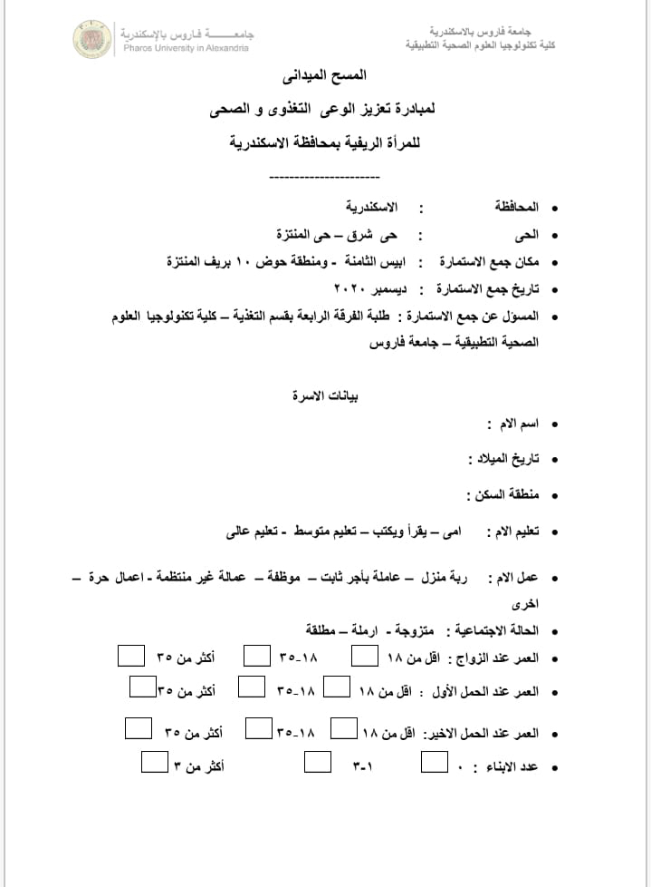

Slide 25
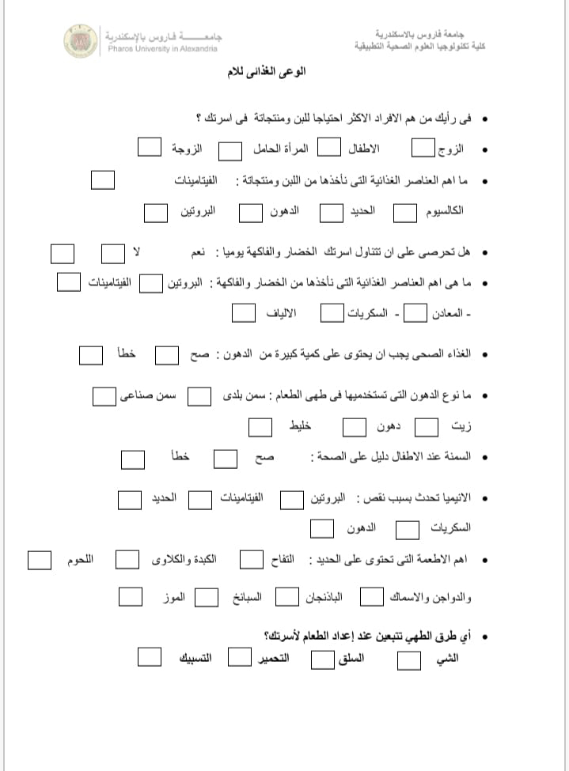
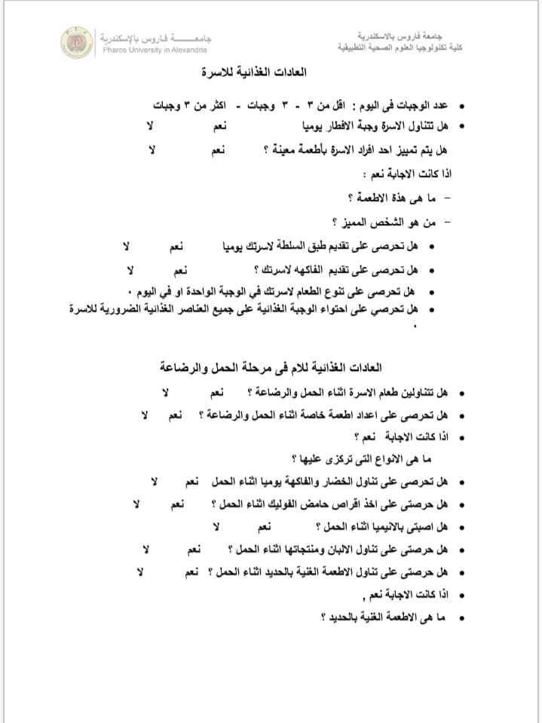

Slide 26
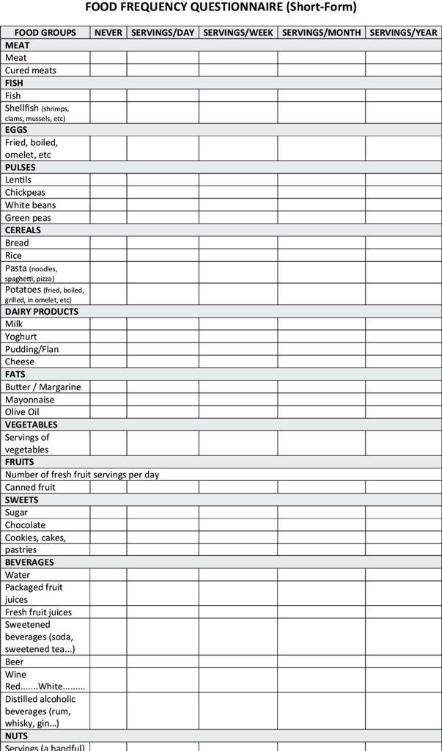

Slide 27
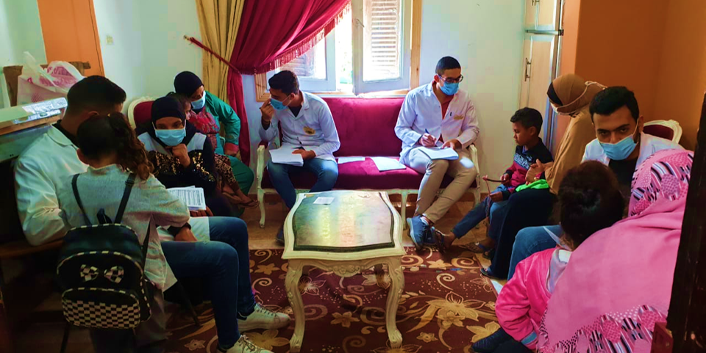

Slide 28





Data Collection
Anthropometric Assessment
weight
Waist circumference
Height
Hip circumference
BMI
Waist to Hip ratio

Slide 29
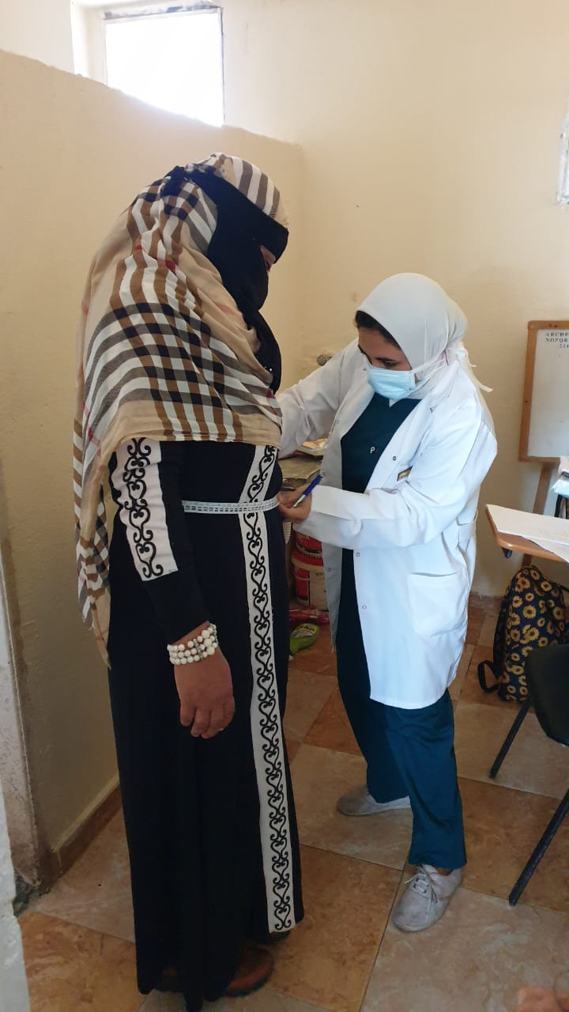
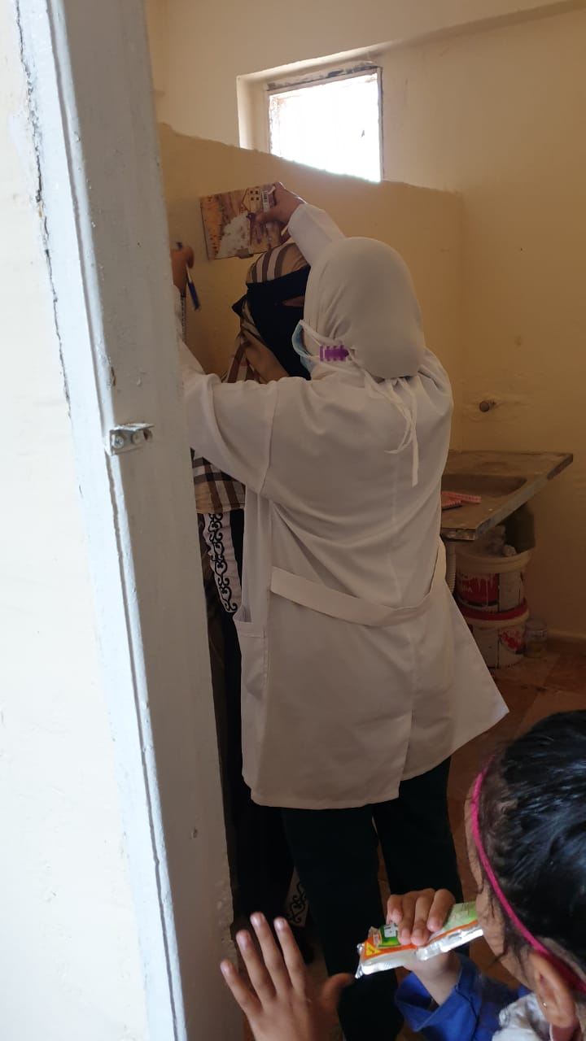

Slide 30

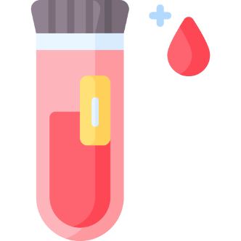



Data Collection
Biochemical Tests
CBC
Lipid profile
HbA1c
TSH
Stool
Urine

Slide 31


Dietary Intake Analysis

Slide 32

Dietary Intake Analysis
Nutritionist Pro Diet Analysis
Software Assessment

Slide 33
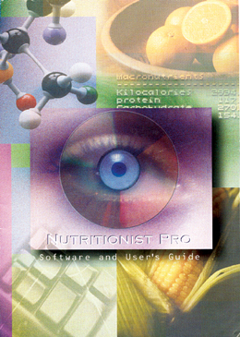
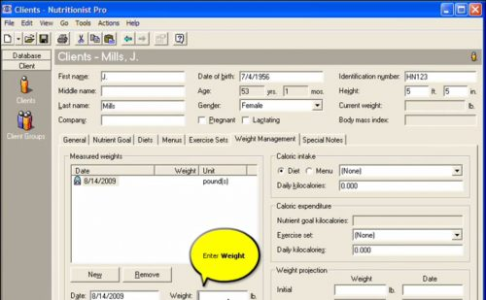
Dietary Intake Analysis

Slide 34
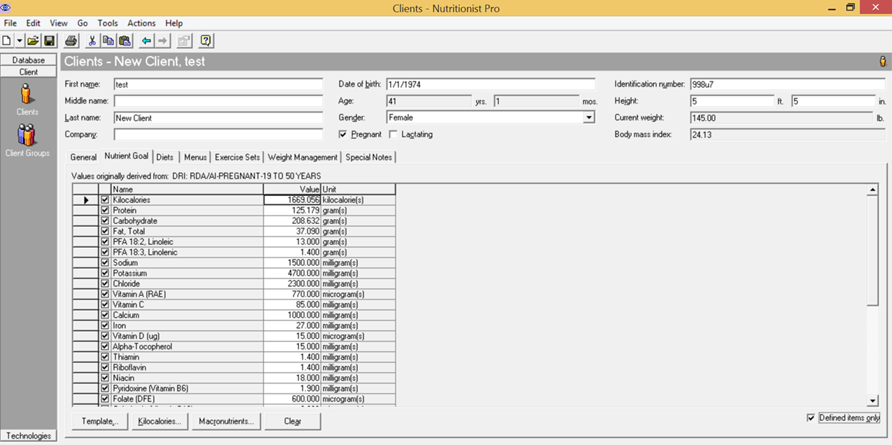

Slide 35
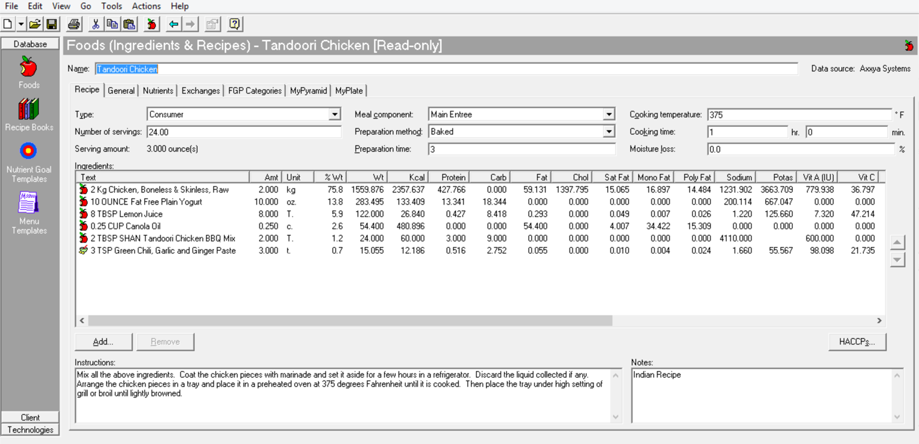

Slide 36

Educational sessions

Slide 37

Educational sessions
We were divided into 3 groups
for a period of 1 month
on a weekly basis

Slide 38

Educational sessions
We chose the topics according to the mother’s needs
We constructed simple educational messages in simple words

Slide 39

Educational sessions
We used
data show, posters & flyers

Slide 40
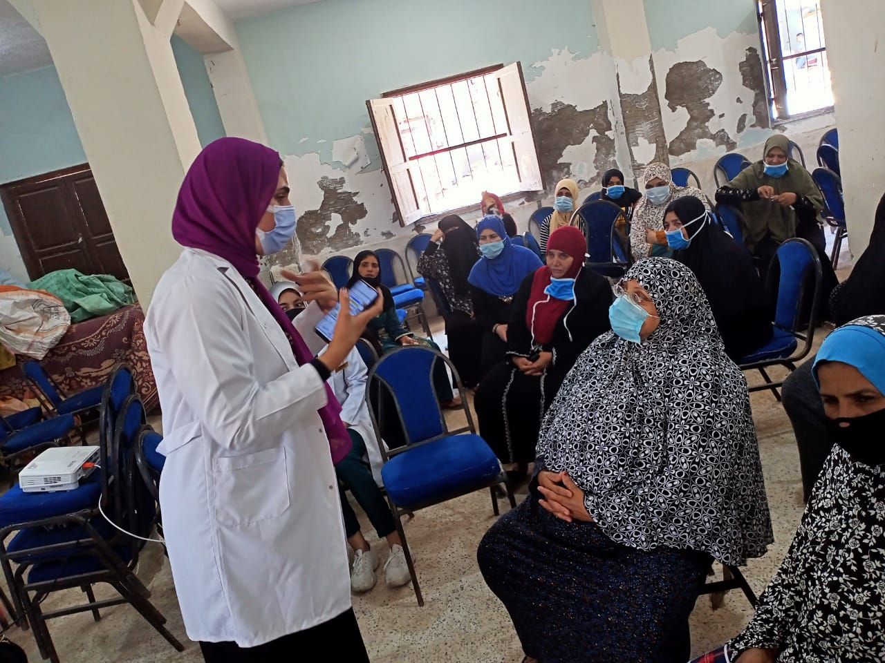
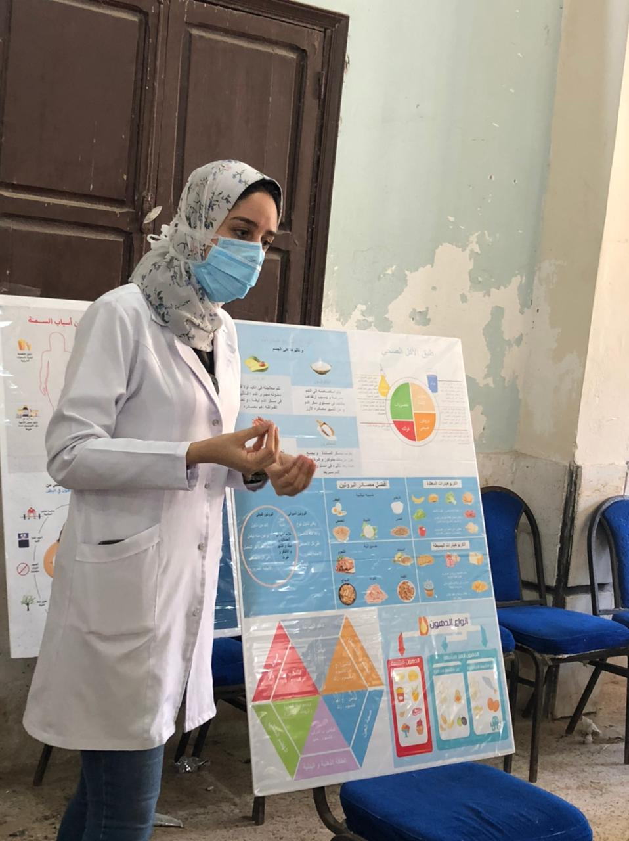

Slide 41
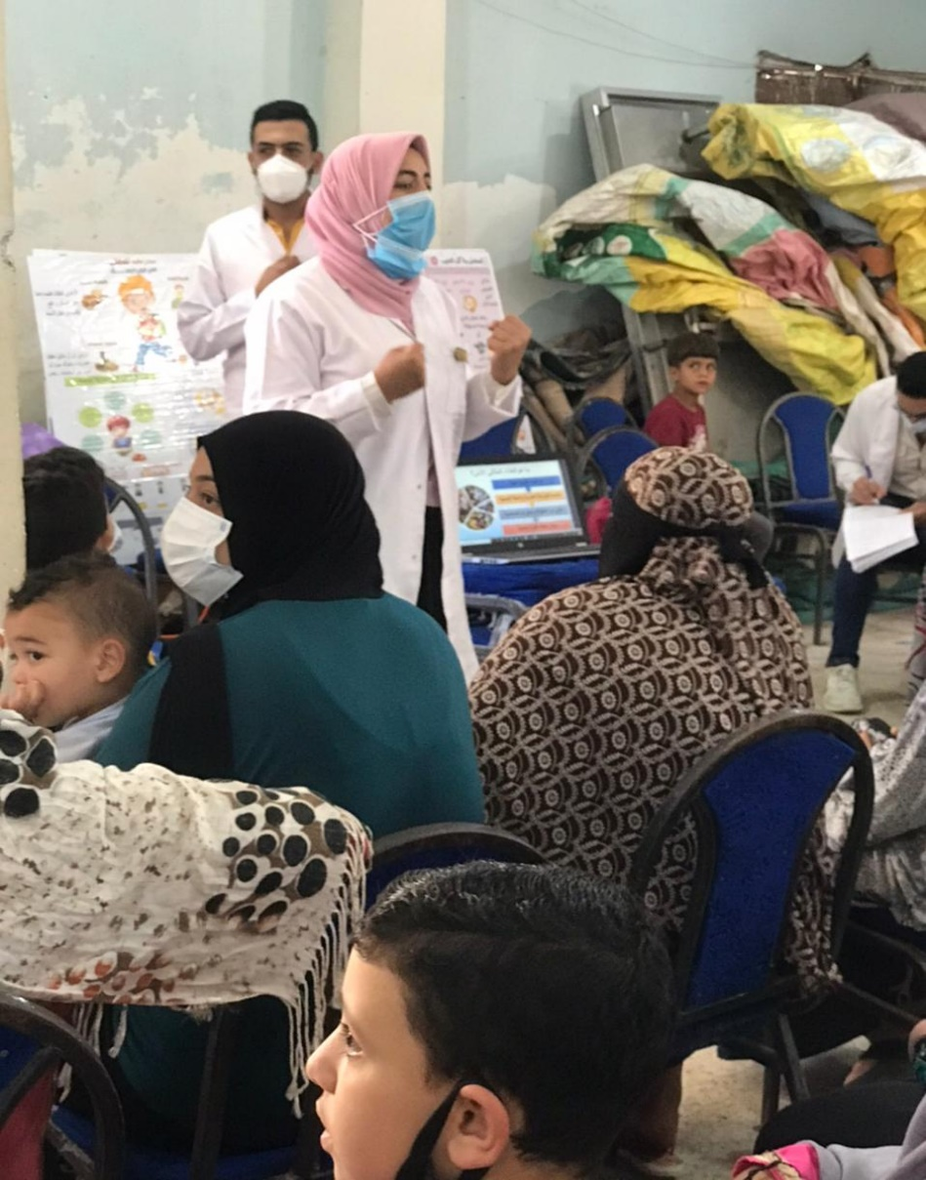
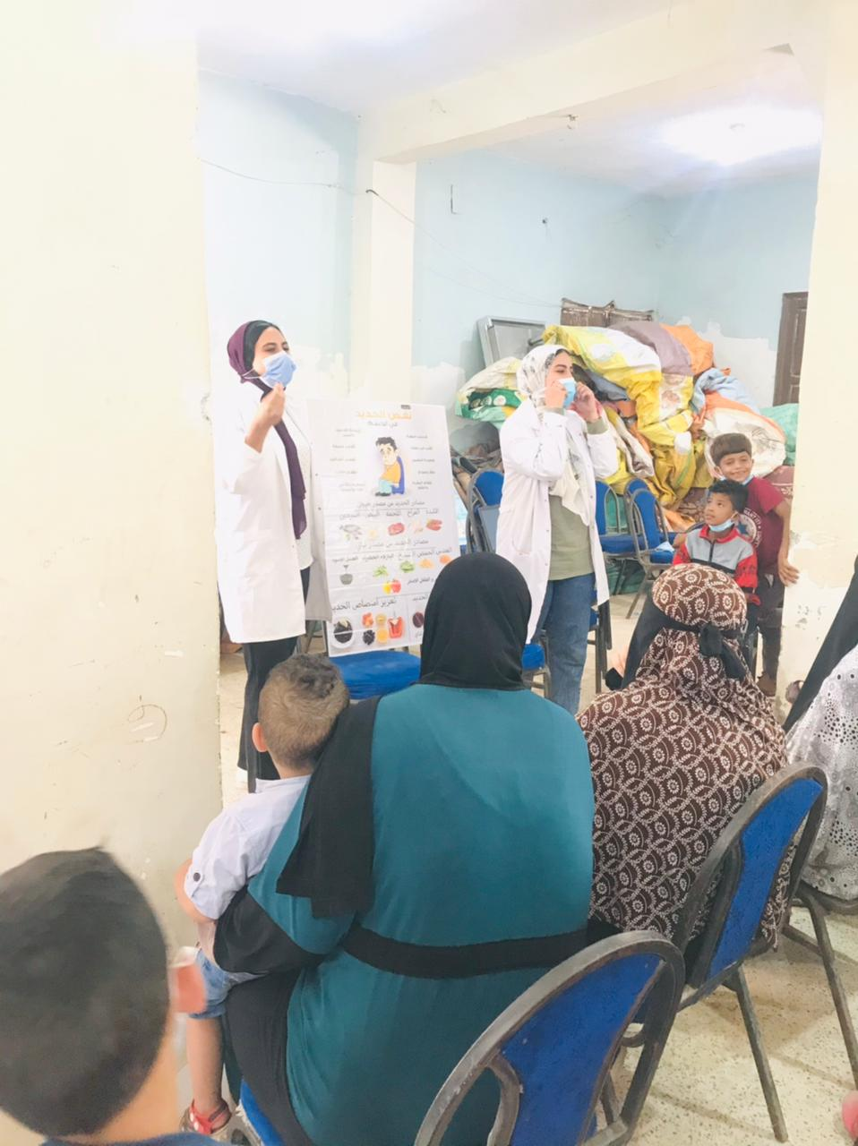

Slide 42
Our topics
  01
  Nutrition during Pregnancy and Lactation.
  02
  Iron deficiency anemia and Iron sources, enhancers and inhibitors of absorption.
  03
  Good Complementary Feeding and Child Feeding Practices.
  04
  Causes of obesity, its risk factors and how to manage such a chronic relapsing disease.

Slide 43
Educational sessions
Finally; we recollected the
“Data knowledge and awareness part of the questionnaire”
to compare them with the pre-intervention
data to evaluate our outcome.

Slide 44
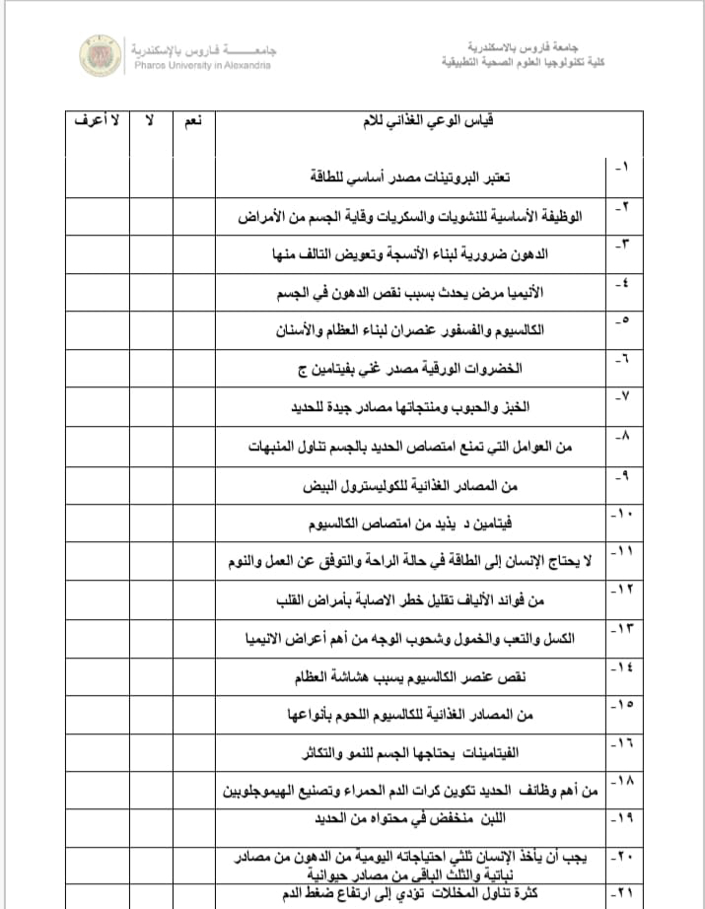
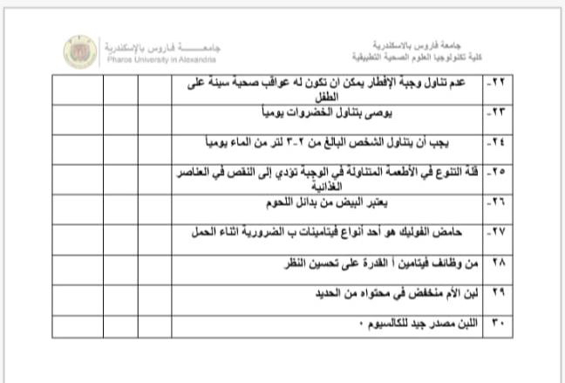

Slide 45
Result

Slide 46
Distribution of the studied cases according to education level

Slide 47
Distribution of the studied cases according to work

Slide 48
Distribution of the studied cases according to
Marital status

Slide 49
Distribution of the studied cases according to
number of children

Slide 50
Distribution of the studied cases according to health information (n=229)

Slide 51
Distribution of the studied cases according to
number of meals and have breakfast daily (n=229)

Slide 52
Distribution of the studied cases according to
special dietary habits (n=229)

Slide 53
Distribution of the studied cases according to
family food habits (n=229)

Slide 54
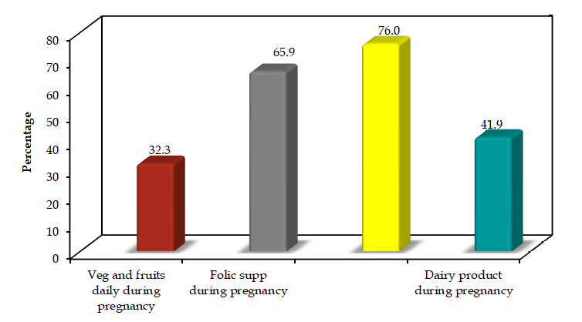
Distribution of the studied cases according to nutritional habits during pregnancy and lactation (n=229)
Iron supp during pregnancy

Slide 55
Distribution of the studied cases according to rich food with iron during pregnancy (n=229)

Slide 56
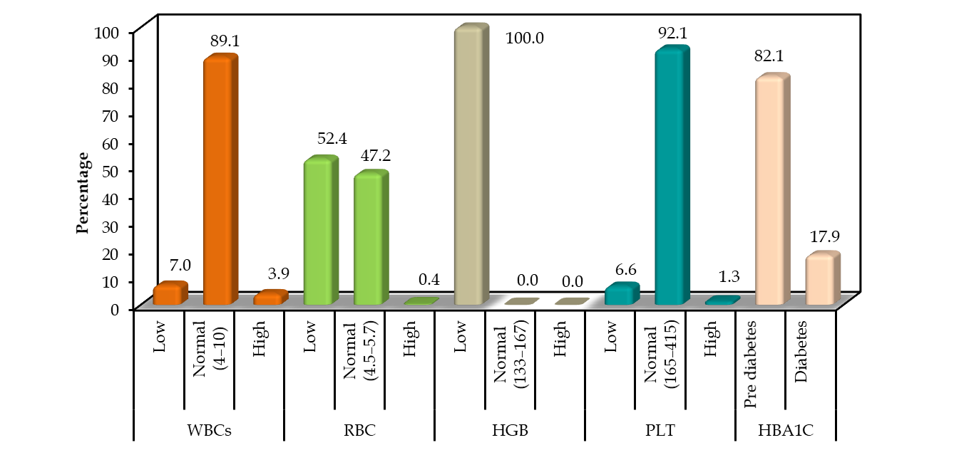
Distribution of the studied cases according to laboratory investigation (n=229)

Slide 57
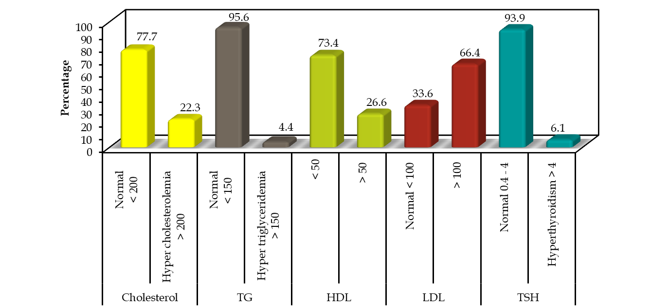
Distribution of the studied cases according to laboratory investigation (n=229)

Slide 58
Distribution of the studied cases according to body
mass index (BMI)

Slide 59
Distribution of the studied cases according to nutritional information (n=229)

Slide 60
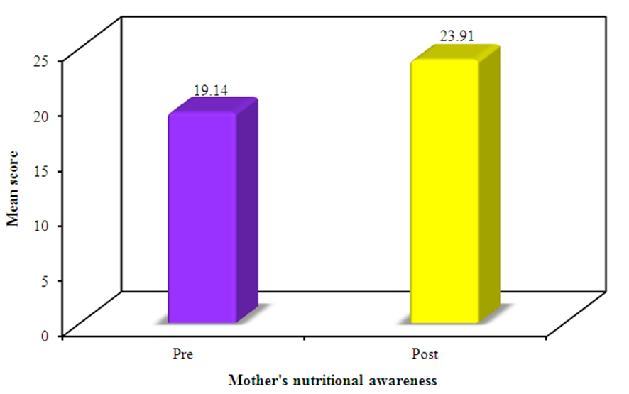
Distribution according to mother's nutritional awareness pre-and post intervention
Statistically significant p< 0.001

Slide 61

Conclusion

Slide 62







Conclusion
The Target Group
+
low educational level
Low nutritional knowledge
+
obesity
anaemia
high prevalence
Double Burden of Malnutrition

Slide 63




Conclusion
Educational sessions
Increased
Nutritional Awareness

Slide 64
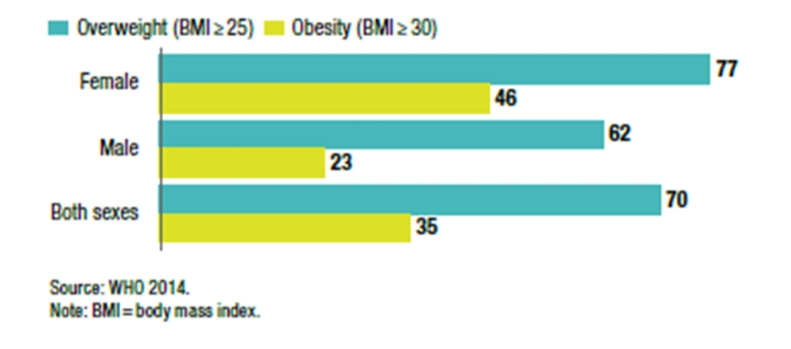
Conclusion
Our findings even exceeded the official statistics recently published by the ministry of health

Slide 65

Recommendations

Slide 66
Recommendations
يوصى ببرامج التوعية التغذوية الدورية واسعة النطاق خاصة في المناطق الريفية لتعزيز المعرفة المستدامة.
وتشجيع تبني ممارسات أسلوب الحياة الصحي
على مستوى الأسرة والمجتمع.

Slide 67

Recommendations
يوصى بالتقييم الغذائي المنتظم والتدخل في سن مبكرة للإناث في المناطق الريفية لتجنب سوء التغذية
وتشجيع المنظمات غير الحكومية على المشاركة في تعزيز أسلوب الحياة الصحي في المناطق الريفية للتعظيم من الجهود الحكومية

Slide 68
References
Ministry of Health and Population. 2015 Egypt Health Issues Survey (EHIS), October 2015.
In collaboration with: El Zanaty and Associates, USAID, UNFPA and UNICEF.
Egypt Demographic and Health Survey 2014
Egypt Action Plan For NCDs 2018-2022. Egypt Multisectoral Action Plan for Noncommunicable Diseases Prevention and Control. 2018 – 2022
100 Millionseha.eg
CAPMAS

Slide 69




Thank you

